Slide 1
Microservices with Spring Boot 4.0.1

Slide 2
What is an Enterprise Application?
Examples
Amazon
Flipkart
Banking System
Hospital Management
Airline Reservation
University ERP
Characteristics
Thousands or millions of users
Large databases
High availability
Secure
Scalable
Reliable
Notes:
What happens if Amazon goes down during a festival sale?"
"What happens if a banking server crashes?"
Enterprise applications cannot simply restart whenever a problem occurs.
They must be designed for reliability and continuous availability.
This requirement influences architectural decisions.

Slide 3
Why Architecture Matters
A good architecture helps achieve:
Scalability
Performance
Maintainability
Reliability
Security
Availability
Business Requirements
↓
Software Architecture
↓
High Quality Application
Notes:
Architecture is actually a blueprint that determines how software will evolve over time.
Changing architecture after several years of development is extremely difficult.
Choosing the right architecture at the beginning saves significant cost later.

Slide 4
Evolution of Software Architecture
Desktop Application
↓
Client-Server
↓
Three-Tier
↓
Monolithic
↓
Microservices
Notes:
Desktop Applications : Everything runs on one computer.
Client-Server : Clients communicate with a centralized server.
Three-Tier : Presentation, Business Logic, Database become separate layers.
Monolithic : Entire application packaged together.
Microservices : Application divided into multiple independently deployable services.

Slide 5
E-Commerce Order Management System

Slide 6
Problem Statement
Design and develop a distributed E-Commerce Order Management System that enables customers to purchase products while maintaining inventory and generating order notifications.

Slide 7
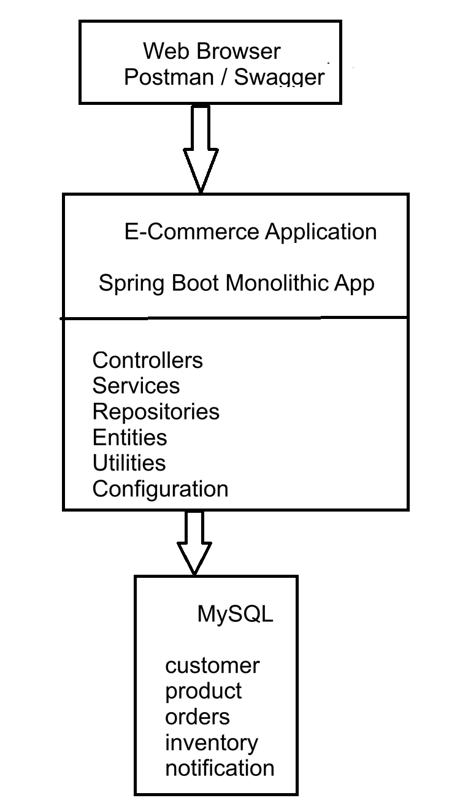
Monolithic Architecture
Notes:
Characteristics
Single Codebase
Single Deployment
Shared Database
One Runtime

Slide 8
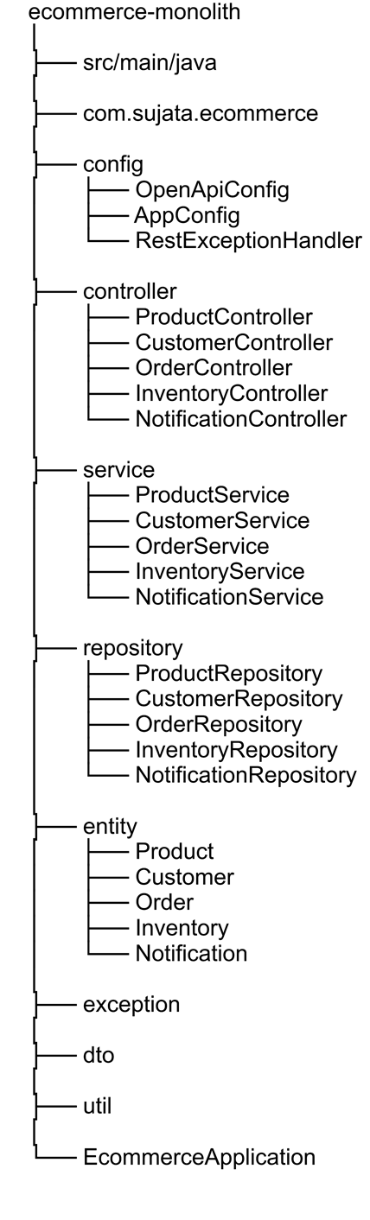
Project Structure in Monolithic Application
Notes:
Controller : Receives HTTP requests.
Service : Business logic.
Repository : Communicates with database.
Database : Stores application data.

Slide 9
Advantages of Monolithic Architecture
Easy to develop
Easy to deploy
Faster internal communication
Easier debugging
Lower infrastructure cost

Slide 10
Limitations of Monolithic Architecture
Tight coupling
Large codebase
Difficult scaling
Longer deployments
Single point of failure
Notes:
Monolithic architecture is not bad.
For small projects, startups, prototypes, and internal tools, it is often the best choice.
Problems become significant only as applications grow in size and complexity.

Slide 11
Why Organizations Moved to Microservices
Imagine a festive sale.
Product Module
100,000 Requests
Payment Module
8,000 Requests
Notification
2,000 Requests
Question: Should we scale the entire application just because Product traffic increased?
Notes:
"If only the Product Catalog is under heavy load, why should we deploy five additional copies of the Payment module?"

Slide 12
Introducing Microservices

Slide 13
What are Microservices?
A Microservice is a small, independent application that implements a single business capability.
Unlike a monolithic application, each microservice is:
Independently developed
Independently tested
Independently deployed
Independently scaled
Each microservice owns its:
Source Code
Business Logic
Database
Configuration
Deployment Lifecycle
Notes:
So far, we've seen that a monolithic application packages everything into one deployable unit.
Microservices solve this by dividing the application into small autonomous services.
Think of an organization.
Instead of having one employee doing everything, we create specialized departments.
HR
Finance
Sales
Marketing
Each department performs one responsibility.
Microservices follow exactly the same philosophy.

Slide 14
E-Commerce Microservices Example
Client
│
API Gateway
│
┌────────┬────────┬─────────┬─────────┐
│ │ │ │
Product Order Payment Inventory
Service Service Service Service
│ │ │ │
ProductDB OrderDB PaymentDB InventoryDB
Additional Services
Customer Service
Notification Service
Shipping Service
Notes:
Imagine Amazon.
Would Amazon keep Orders, Products, Payments and Notifications inside one application?
No.
Instead, every business capability becomes an independent service.
If Product Service crashes,
Payment Service continues running.
Customers can still make payments.
This improves availability.

Slide 15
Characteristics of Microservices
Single Responsibility
Independent Deployment
Independent Database
API-Based Communication
Independent Scaling
Fault Isolation
Notes:
These six characteristics define almost every microservice architecture.
Throughout the remaining training, every project we build will demonstrate these characteristics.

Slide 16
Single Responsibility Principle
One Service = One Business Capability
Examples
Product Service
↓
Products Only
Order Service
↓
Orders Only
Payment Service
↓
Payments Only
Each service focuses on solving one business problem.
Notes:
Suppose the Product Service starts handling:
Products
Orders
Customers
Payments
It immediately becomes another monolith.
Microservices are successful because they remain focused.
Ask the class:
"What should Product Service know about Credit Card Payments?"
Answer:
Nothing.
That belongs to Payment Service.

Slide 17
Independent Deployment
Traditional Deployment
Small Product Change
↓
Deploy Entire Application
Microservices
Product Change
↓
Deploy Product Service Only

Slide 18
Benefits
Faster releases
Lower downtime
Independent development teams
Notes:
Imagine fixing a spelling mistake in Product Service.
In a monolith,
the entire application must be rebuilt and redeployed.
In microservices,
only Product Service is redeployed.
Everything else continues running.
This dramatically reduces deployment time.

Slide 19
Database per Service
A service should never access another service's database directly.

Slide 20
API-Based Communication
Services communicate exactly the way external clients communicate.
They use:
REST APIs
HTTP
JSON

Slide 21
Independent Scaling
Service | Requests/sec
Product | 100,000
Order | 20,000
Payment | 8,000
Notification | 1,500
Imagine this traffic:
Only Product Service requires additional instances.
Load Balancer
│
┌────┴────┐
Product Product
Service Service
Notes:
Scaling is one of the biggest advantages.
During Diwali or Black Friday,
millions of users browse products,
but only a small percentage purchase.
Why should Payment Service consume additional servers?
Only Product Service should scale.
This reduces infrastructure costs.

Slide 22
Fault Isolation
Scenario
Notification Service crashes.
Question:
Can customers still browse products?
Answer
✔ Yes
Can they place orders?
✔ Yes
Can payments continue?
✔ Yes
Only notifications stop working.
Notes:
Failures become isolated.
Instead of losing the entire application,
only one business capability is temporarily unavailable.
This significantly improves system availability.

Slide 23
Monolithic vs Microservices
Feature | Monilithic | Microservice
Deployment | Single Application | Independent Services
Codebase | Single | Multiple
Database | Shared | Database per Service
Scaling | Entire Application | Individual Service
Technology | Usually One | Can Vary
Failure | May Affect Entire System | Unually Isolated
Team Structure | One Large Team | Multiple Teams
Cloud Rediness | Limited | Excellent
Notes:
there is no universally "best" architecture.
Choose Monolithic when:
Building an MVP or prototype
Working with a small team
Requirements are simple
Fast initial development is the goal
Choose Microservices when:
The application is large and evolving
Independent deployment is required
Different services need different scalability
Multiple teams work in parallel
The system is designed for cloud environments

Slide 24
Why Spring Boot?

Slide 25
What is Spring Boot?
Spring Boot is an extension of the Spring Framework that simplifies Java application development by providing sensible defaults and reducing configuration.
Why Developers prefer Spring Boot
Less configuration
Faster development
Production-ready
Embedded Tomcat
Auto Configuration
Starter Dependencies
Excellent for REST APIs
Cloud-friendly
Notes:
How many configuration files do you think are required to start a Java web application in traditional Spring?"
Many.
Spring Boot dramatically reduces this effort.
Instead of spending hours configuring XML files, dependency injection, servlet containers, and web descriptors, Spring Boot provides opinionated defaults so developers can focus on business logic.
"Spring Boot doesn't replace Spring—it simplifies using Spring."

Slide 26
Why Spring Boot for Microservices?
Rapid Development
Minimal Configuration
Embedded Server
Easy Deployment

Slide 27
Spring Boot Features
Auto Configuration
Automatically configures components based on dependencies.
Starter Dependencies
One dependency adds all required libraries.
Example
spring-boot-starter-web
Includes
Spring MVC
Jackson
Embedded Tomcat
Validation Support

Slide 28
Spring Boot Features
Embedded Web Server
No external Tomcat installation required.
Externalized Configuration
Configuration stored in:
application.properties
Notes:
When we add spring-boot-starter-web, we don't manually download dozens of JAR files.
Spring Boot manages compatibility between libraries.
Similarly,
Embedded Tomcat means:
Simply click Run.
No manual deployment to Tomcat is needed.

Slide 29
What is an API?

Slide 30
API (Application Programming Interface)
An API is a contract that allows two software applications to communicate with each other.
Real-World Examples
Amazon App ↔ Backend Server
Swiggy App ↔ Restaurant System
UPI App ↔ Bank Server
Mobile App ↔ Spring Boot Application

Slide 31
What is REST?
Representational State Transfer
REST is an architectural style used to build web services using HTTP.
REST is Resource-Oriented
Examples of Resources
Products
Customers
Orders
Payments
Each resource is identified using a unique URL.
Example
/products
/orders
/customers
Notes:
REST is not a programming language.
REST is a set of design principles.
Everything revolves around resources.
Don't think in terms of methods like:
CreateProduct()
DeleteProduct()
Instead think about Products.
Operations happen using HTTP methods.

Slide 32
REST Architecture
Client
│
HTTP Request
│
REST API
│
Business Logic
│
Database
│
JSON Response
│
Client

Slide 33
Characteristics
Stateless
Client-Server
Uniform Interface
Resource-Based
Cacheable
Notes:
Each request is independent.
Example:
GET /products/5
contains everything needed.
The server does not remember previous requests.
This improves scalability.
Ques : "Can the server forget me after sending the response?"
Answer:
Yes.
That's exactly what Stateless means.

Slide 34
HTTP Methods
CRUD Operations
HTTP Method | Operation
GET | Read
POST | Create
PUT | Update
DELETE | Delete

Slide 35
REST Guidelines
Use nouns
Use plural names
Keep URLs meaningful
Use Path Variables

Slide 36
HTTP Status Codes
Successful Responses
Code | Meaning
200 | OK
201 | Created
204 | No Content

Slide 37
HTTP Status Codes
Client Errors
Code | Meaning
400 | Bad Request
404 | Not Found

Slide 38
HTTP Status Code
Server Errors
Code | Meaning
500 | Internal Server Error

Slide 39
REST API Design Best Practices
Follow These Rules
Use HTTP Methods Correctly
Use Meaningful URLs
Return Proper Status Codes
Exchange JSON
Keep APIs Stateless
Validate Input
Handle Errors Gracefully

Slide 40
Building the Product Service

Slide 41
Creating a Spring Boot Project
Property | Value
Project | Maven
Language | Java
Spring Boot | 4.0.1
Java | 21
Packaging | JAR
Spring Initializr Settings
Required Dependencies
Spring Web
Spring Data JPA
Validation
MySQL Driver
Notes:
Spring Web
Creates REST APIs.
Spring Data JPA
Simplifies database access.
Validation
Validates incoming requests.
MySQL Driver
Allows Java to communicate with MySQL.

Slide 42
Configure MySQL
application.properties
spring.datasource.url=jdbc:mysql://localhost:3306/productdb?createDatabaseIfNotExist=true&useSSL=false&allowPublicKeyRetrieval=true&serverTimezone=UTC
spring.datasource.username=root
spring.datasource.password=******
spring.datasource.driver-class-name=com.mysql.cj.jdbc.Driver
spring.jpa.hibernate.ddl-auto=update
logging.level.org.hibernate.SQL=DEBUG
logging.level.org.hibernate.orm.jdbc.bind=TRACE
Notes:
The JDBC URL:
jdbc:mysql://localhost:3306/productdb?createDatabaseIfNotExist=true&useSSL=false&allowPublicKeyRetrieval=true&serverTimezone=UTC
can be broken down into two parts:
Connection details
Connection parameters (after ?)
Complete Breakdown
jdbc:mysql://localhost:3306/productdb
jdbc:mysql://
jdbc → Java Database Connectivity protocol.
mysql → Specifies that the MySQL JDBC driver should be used.
localhost
The hostname of the MySQL server.
localhost means the database is running on the same machine as your Spring Boot application.
Example:
localhost
If the database is on another machine:
192.168.1.10
or
db.company.com
3306
MySQL server port.
3306 is the default MySQL port.
Example:
localhost:3306
means
Connect to MySQL running on port 3306.
productdb
This is the database/schema name.
Example:
CREATE DATABASE productdb;
Spring Boot will connect to this database.
Parameters
Everything after ? consists of key=value pairs separated by &.
1. createDatabaseIfNotExist=true
createDatabaseIfNotExist=true
Meaning
If productdb does not exist, MySQL automatically creates it.
Without this:
Unknown database 'productdb'
With this:
Database productdb created automatically.
Useful during development.
2. useSSL=false
useSSL=false
Meaning
Disable SSL/TLS encryption between your application and MySQL.
When your application connects:
Spring Boot
|
|
MySQL
communication is not encrypted.
Why?
For local development there is no need for SSL.
In production:
useSSL=true
is recommended.
3. allowPublicKeyRetrieval=true
allowPublicKeyRetrieval=true
This is one of the most commonly asked interview questions.
Why is it needed?
MySQL 8 uses the authentication plugin:
caching_sha2_password
When SSL is disabled, the client may need the server's RSA public key to securely send the password.
Without this option, you might get:
Public Key Retrieval is not allowed
Setting:
allowPublicKeyRetrieval=true
allows the JDBC driver to retrieve the server's public key automatically.
Typically used together with:
useSSL=false
4. serverTimezone=UTC
serverTimezone=UTC
Meaning
Tells the JDBC driver which time zone the MySQL server uses.
Without it, you may see errors such as:
The server time zone value is unrecognized
or timestamps may be interpreted incorrectly.
Examples:
UTC
Asia/Kolkata
Europe/London
America/New_York
Using UTC avoids many timezone-related issues and is a common production practice.

Slide 43
Create the Product Entity
@Entity
@Table(name = "products")
public class Product {
@Id
@GeneratedValue(strategy = GenerationType.IDENTITY)
private Long id;
@Column(name = "product_code", nullable = false, unique = true, length = 20)
private String productCode;
@Column(nullable = false, length = 100)
private String name;
@Column(nullable = false, length = 500)
private String description;
@Column(nullable = false, length = 50)
private String category;
@Column(nullable = false)
private BigDecimal price;
@Column(name = "stock_quantity", nullable = false)
private Integer stockQuantity;
//constructor and getter and setter
}
Notes:
@Entity → Marks a persistent class
@Table → Specifies the table name
@Id → Primary key
@GeneratedValue → Auto-generates IDs

Slide 44
Repository Layers
JpaRepository<Product, Long>
Provides built-in CRUD methods:
save()
findAll()
findById()
deleteById()
count()

Slide 45
Service Layer
Contains:
Business Rules
Validation Logic
Workflow Coordination

Slide 46
Build the REST Controller
Method | URL
GET | /products
GET | /products/{id}
POST | /products
PUT | /products/{id}
DELETE | /products/{id}
Endpoints
Key Annotations
@RestController
@RequestMapping
@GetMapping
@PostMapping
@PutMapping
@DeleteMapping

Slide 47
Input Validation
Why Validation?
Prevent invalid data from entering the system.
Example Rules
Product name cannot be blank
Price must be positive
Quantity must be positive
Common Annotations
@NotBlank
@Positive
@Valid

Slide 48
Global Exception Handling
Why?
Without exception handling:
Stack traces
Technical error messages
Poor user experience
Solution
Use:
@RestControllerAdvice
with
@ExceptionHandler
Benefits
Centralized error handling
Cleaner controllers
Consistent API responses

Slide 49
Global Exception Handling Example
@RestControllerAdvice
public class GlobalExceptionHandler {
@ExceptionHandler(MethodArgumentNotValidException.class)
public ApiError handleValidationException(MethodArgumentNotValidException ex, HttpServletRequest request) {
String message = ex.getBindingResult().getFieldErrors().stream().map(FieldError::getDefaultMessage)
.collect(Collectors.joining(", "));
return new ApiError(LocalDateTime.now(), HttpStatus.BAD_REQUEST.value(),
HttpStatus.BAD_REQUEST.getReasonPhrase(), message, request.getRequestURI());
}
}
//Entity
public class ApiError {
private LocalDateTime timestamp;
private int status;
private String error;
private String message;
private String path;
}

Slide 50
Complete Application Flow
Client
│
▼
REST Controller
│
▼
Service Layer
│
▼
Repository
│
▼
MySQL Database

Slide 51
Final Project Structure
product-service
│
├── controller
├── service
├── repository
├── entity
├── exception
└── ProductApplication

